Slide 1
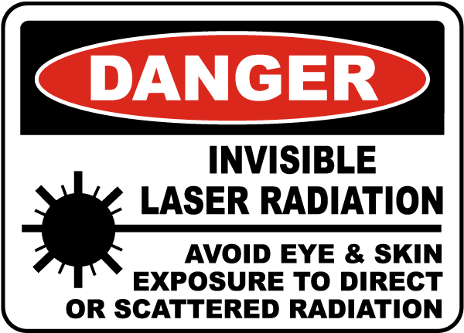


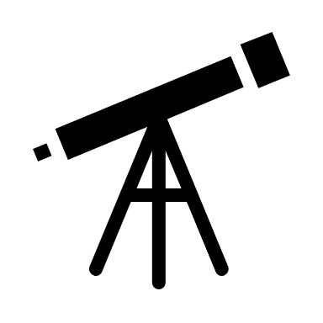
DO NOT POINT TELESCOPE
DIRECTLY AT THE SUN
OR SUPERNOVA
FIRE OR LOSS OF EYESIGHT COULD OCCUR

